Slide 1

Ethical Hacking Course
Week 6: Enumeration
presentation slides to accompany
CEHv11 Certified Ethical Hacker Exam Study Guide
author: Ric Messier; © 2021 John Wiley & Sons

Slide 2
What Is Enumeration?
Gathers detailed information beyond scanning
Uses different protocols such as ICMP and SNMP
Can create effective picture of network
Relies on both manual and automated methods
Overall Enumeration is: The process of counting off or listing what services, applications, and protocols are present on each identified computer..

Slide 3
Service Enumeration
Service Enumeration can run via nmap by using -sV
Expect to gain even more information during this step as you are digging deeper and gathering information such as:
open ports
Services and versions that are running on the hosts that were found responding on the network.
It does this by looking at any application banners to extract details about the service name and version.

Slide 4
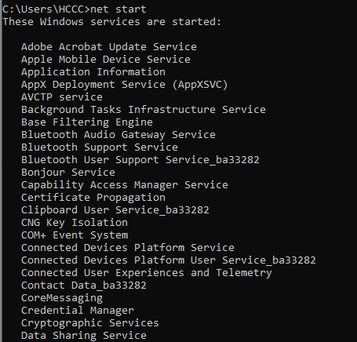
Listing services from the DOS Prompt

Slide 5
Listing services with systemctl
The list-units option will list all services, regardless of whether they are active or not.
systemctl list-units --type=service
systemctl list-units --type=service --all, meanwhile, shows services that are active or have failed.
You can filter those to only active service by using:
systemctl list-units -a --state=active

Slide 6
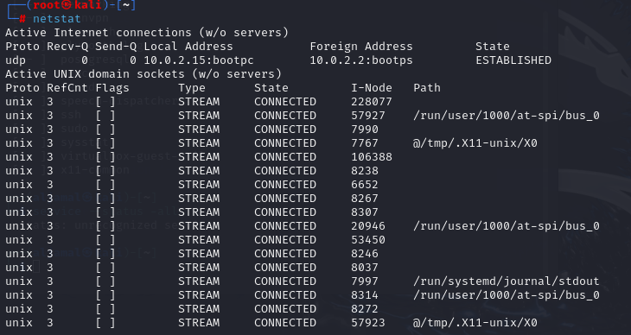
Ports status and netstat linux command

Slide 7
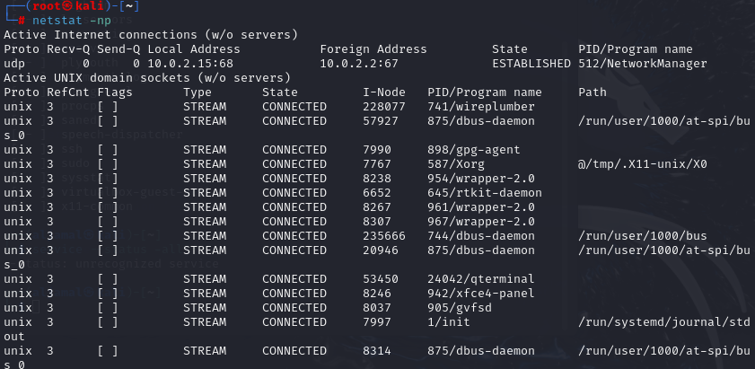
Ports status and netstat –np linux command

Slide 8
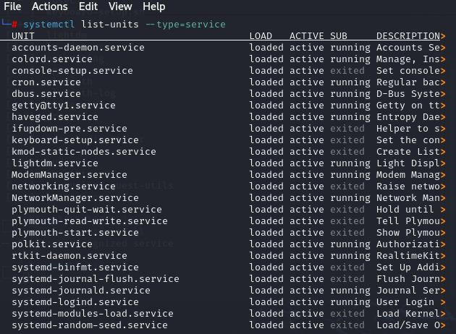
systemctl list-units --type=service

Slide 9
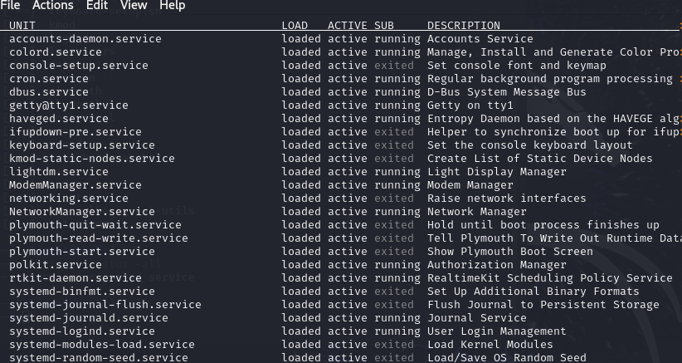
Service/continued

Slide 10
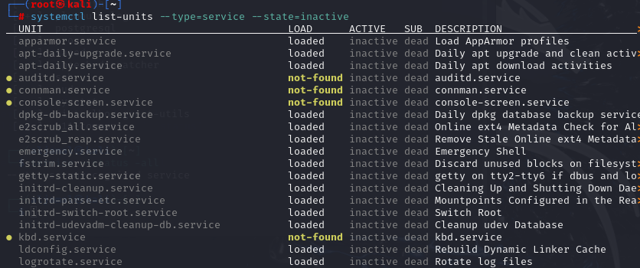
Listing inactive/active service

Slide 11
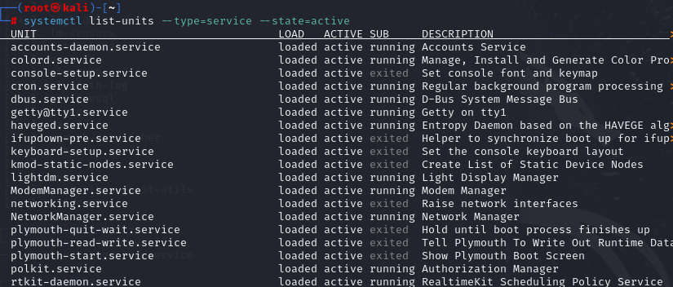
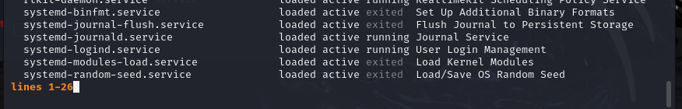
active
Ctrl c to exit

Slide 12
What to Uncover and How
The process of enumeration is finding out about what services are running, including versions, open shares, account details, or possible points of entry..
When scanning systems, nmap is always your friend. The same is true when it comes to service enumeration. This means you are identifying the service running on the target system.
A quick way to do that is to use the version scan built into nmap.
Network services may have many implementations
The application that’s vulnerable and not the “service”

Slide 13
Nmap scan
┌──(root㉿kali)-[~]
└─# nmap -T4 -P –A
-T4 speed, -P all ports, -A top 1000 ports
Starting Nmap 7.94SVN ( https://nmap.org ) at 2024-08-08 12:30 EDT
WARNING: No targets were specified, so 0 hosts scanned.
Nmap done: 0 IP addresses (0 hosts up) scanned in 0.34 seconds
┌──(root㉿kali)-[~]
└─# nmap -T4 -P -A 127.0.0.1
Starting Nmap 7.94SVN ( https://nmap.org ) at 2024-08-08 12:30 EDT
Nmap scan report for localhost (127.0.0.1)
Host is up (0.000029s latency).
All 1000 scanned ports on localhost (127.0.0.1) are in ignored states.
Not shown: 1000 closed tcp ports (reset)
Too many fingerprints match this host to give specific OS details
Network Distance: 0 hops
OS and Service detection performed. Please report any incorrect results at https://nmap.org/submit/ .
Nmap done: 1 IP address (1 host up) scanned in 1.87 seconds
┌──(root㉿kali)-[~]
└─#

Slide 14
Algorithm Enumeration
Secured Shell SSH encrypts data between the client and the server
The script used to enumerate the algorithms across Secured Shell SSH servers: ssl-enum- ciphers. nse

Slide 15
You never know where you may run across a vulnerability.
It is useful to have a good knowledge about services.

Slide 16
Remote Procedure Calls(RPCs)
Service that allows remote systems to consume procedures external to the application calling them.
A program on system A can call a function or procedure on another system across the network.
The program calls this procedure, gets the information, and proceeds on its way. (inner process communication)

Slide 17
Server Message Block (SMB)
A communication protocol used to share files, printers, serial ports, and miscellaneous communications
This means SMB knows about users and groups. And shares, which are directories that are exposed to the network.
The most common implementation of remote procedure calls you will run across is the one used in Windows networks.

Slide 18
Built-in Utilities
NetBIOS
Gathering NetBIOS statistics can be accomplished by using the program nbtstat.
This allows you to gather data about the local network.

Slide 19
NetBIOS Enumerator
An open-source tool that will function like nmap
Graphical tool, which makes it easier to locate information more quickly about each system
It shows system’s name and IP address, domain on the network.
It collect info on may items on the network when providing a range of IP address

Slide 20
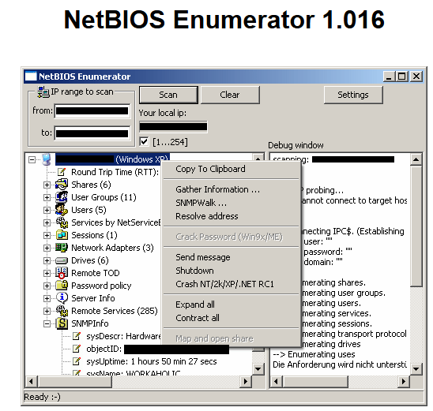
NetBIOS Enumerator
To download click : NetBIOS Enumerator (sourceforge.net)

Slide 21
NetBIOS
Commonly exploited service
Designed for small networks
Is extremely vulnerable
Can be used to extract all sorts of information from a target
Considered a legacy protocol
Still available and running on Windows systems by default
This service was originally intended to assist in the access to resources on a LAN only.

Slide 22
Metasploit
From ch5
Metasploit is known primarily for being an exploit framework
Metasploit can be used for port scanning.
The world’s most used penetration testing framework
Has modules for every aspect of EH (including Enumeration)

Slide 23
Metasploit
Exploitation framework
Written in Ruby
Anyone can write modules for Metasploit using the framework
Modules written for Metasploit can expose variables the user needs to define
msfconsole is the command line program used to interact with Metasploit

Slide 24
Metasploit
Using Metasploit can look for SMB versions across the network.
Windows XP system is running SMB version 1 because version 2 didn’t come out until Windows Vista was released.
According to the SMB version history, the Windows 7 system would be using SMB version 2.1.
SMB Version Scan with Metasploit
msf auxiliary(scanner/smb/smb_version) > run

Slide 25
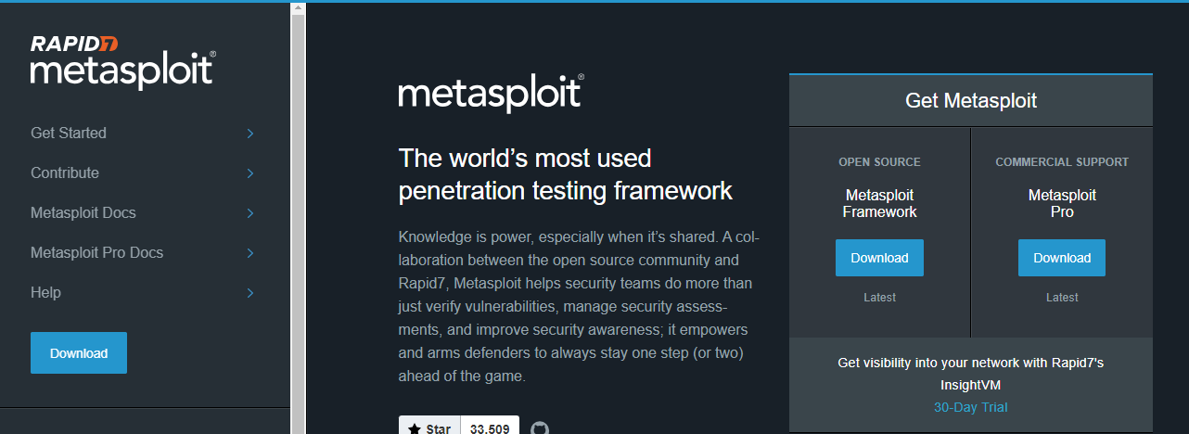
https://www.metasploit.com/

Slide 26
Web Enumeration
Things we want to look at on web Servers:
The first is to identify directories available in a website
dirb Directory Testing
root@aljamal:~# dirb http://192.160.66.12/
Metasploit has a large number of modules that can be used for web-based enumeration beyond just identifying directories

Slide 27
Linux and UNIX Enumeration
Not as vulnerable to enumeration as Windows systems
Tools
Rpcclient
Showmount
Finger
Rpfinfo
Enum4linux
After any type of Linux or UNIX system is found, further probing is still required to determine what it's running.

Slide 28
Some of the techniques used to exploit Linux systems
Rpcclient: Using the rpcclient command, the attacker can enumerate usernames (for example, rpcclient $> netshareenum).
Showmount: The showmount command displays a list of all clients that have remotely mounted a file system from a specified machine in the host parameter.
Finger: The finger command enumerates the user and the host. It enables the attacker to view the user's home directory, login time, idle times, office location, and the last time the user or host received or read mail. This service is typically off. By default, it runs on port 79.
Rpfinfo: The rpfinfo command helps to enumerate the RPC protocol. It makes an RPC call to an RPC server and reports what it finds.
Enum4linux: The enum4linux command is used for enumerating information from Windows and Samba systems. The application basically acts as a wrapper around the Samba commands smbclient, rpclient, net, and nmblookup.

Slide 29
Summary
Enumeration follows scanning.
Enumeration seeks to reveal information from a system.
Enumeration is an active measure.
Information can include usernames, group information, printer data, and other data.

